Slide 1

Markov chain simulation in R
Anđela Todorović
Faculty of Science and Mathematics, University of Niš
💌 andjela.todorovic@pmf.edu.rs

Slide 2
Introduction
msm (Jackson 2011) Multi-State Models for panel data;
mcmcR (Geyer and Johnson 2013) Monte Carlo Markov Chain approach;
hmm (Himmelmann 2010) fits hidden Markov models with covariates;
mstate fits Multi-State Models based on Markov chains for survival analysis (de Wreede, Fiocco, and Putter 2011).
markovchain package (Spedicato 2017)

Slide 3
Review of core mathematical concepts
General definitions
Properties

Slide 4
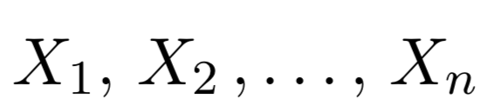
General definitions
Sequence of random variables
that have the Markov property
Markov property:
,,the distribution of the forthcoming state Xn+1 depends only on the current state Xn and doesn’t depend on the previous ones Xn−1, Xn−2, . . . , X1”

Slide 5



General definitions
State space:
Transition probability:
Transition probability in n steps:
,,Time-homogeneous”
Notes:
Consider talking about:
Gambling
A birth-death process
A non-Markov example

Slide 6
Properties
,,accessible” if a system started in state s_{i} has a positive probability to reach the state s_{j} at a certain point
s_{i} and s_{j} ,,communicate” if s_{i} is accessible from s_{j} and vice-versa.
,,communicating class” set of states that communicate
,,irreducible” if all states in the chain communicate. A communicating class is said to be closed if no states outside of the class can be reached from any state inside it.
,,period”
If states belong to the same communicating class, then they have the same period k_{i}.
Notes:
Consider talking about:
Continuous-time Markov chain

Slide 7
The structure of the package
Creating objects
Handling objects

Slide 8
Creating objects
R> library("markovchain")
Class "markovchain" [package "markovchain"]
Slots:
Name: states byrow transitionMatrix
Class: character logical matrix
Name: name
Class: character
Class "markovchainList” [package "markovchain"]
Slots:
Name: markovchains name
Class: list character
Notes:
Consider talking about:
Reducibility
Periodicity
Transience and recurrence
Ergodicity

Slide 9
Creating objects
states: a character vector, listing the states for which transition probabilities are defined.
byrow: a logical element, indicating whether transition probabilities are shown by row or by column.
transitionMatrix: the probabilities of the transition matrix.
name: optional character element to name the DTMC.
1. markovchains: a list of markovchain objects.
2. name: optional character element to name the DTMC.
Notes:
Consider talking about:
Time-homogeneous Markov chain with a finite state space
Convergence speed to the stationary distribution

Slide 10
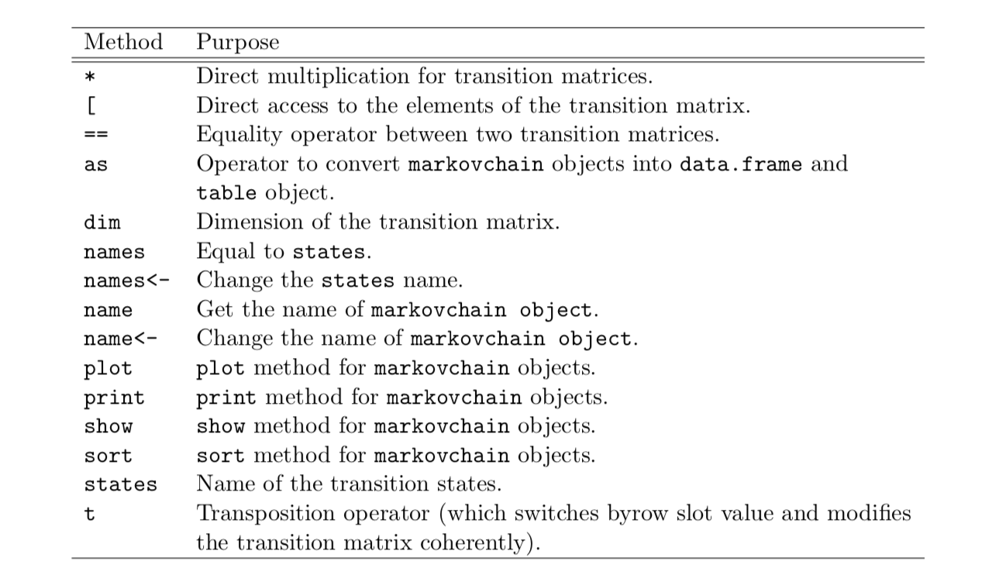
Handling objects

Slide 11
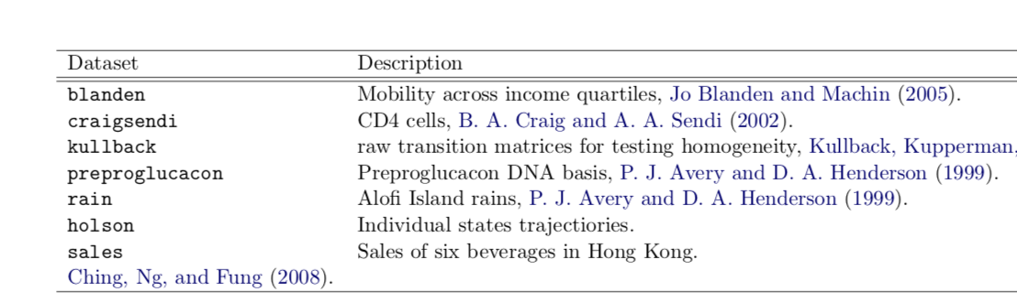
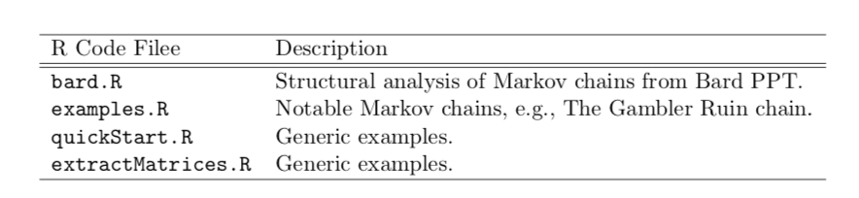
Handling objects

Slide 12
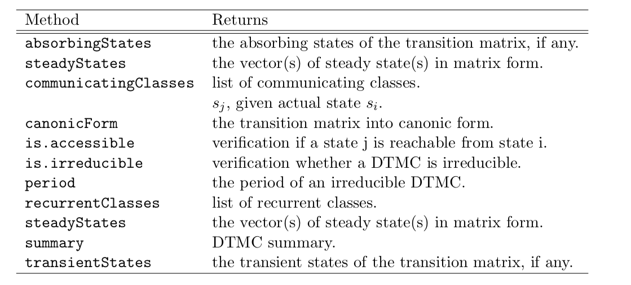
Handling objects

Slide 13
Real world Applications
Weather forecast
Sociology
Genetics and Medicine

Slide 14
Land of Oz
R> mcWP <- new("markovchain", states = c("rainy", "nice", "snowy"),
+ transitionMatrix = matrix(c(0.5, 0.25, 0.25,
+ 0.5, 0, 0.5,
+ 0.25,0.25,0.5), byrow = T, nrow = 3))
R> W0 <- t(as.matrix(c(0, 1, 0)))
R> W1 <- W0 * mcWP; W1
rainy nice snowy
[1,] 0.5 0 0.5
R> W2 <- W0 * (mcWP ^ 2); W2
rainy nice snowy
[1,] 0.375 0.25 0.375
R> W3 <- W0 * (mcWP ^ 3); W3
rainy nice snowy
[1,] 0.40625 0.1875 0.40625
,,The Land of Oz is acknowledged not to have ideal weather conditions at all: the weather is snowy or rainy very often and, once more, there are never two nice days in a row. Consider three weather states: rainy, nice and snowy. ”
R> q <- steadyStates(mcWP) R> q
rainy nice snowy
[1,] 0.4 0.2 0.4

Slide 15
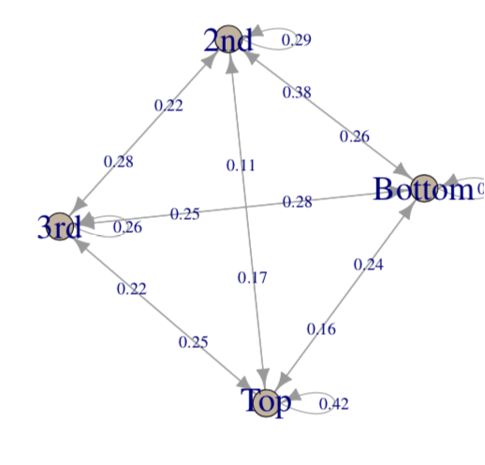
1970 mobility
,, The income quartile of the father when the son was 16 (in 1984) and the income quartile of the son when aged 30 (in 2000) for the 1970 cohort. ”
R> data("blanden")
R> mobilityMc <- as(blanden, "markovchain")
R> mobilityMc
Unnamed Markov chain
A 4 - dimensional discrete Markov Chain defined by the following states: Bottom, 2nd, 3rd, Top
The transition matrix (by rows) is defined as follows:
2nd 3rd Bottom Top
Bottom 0.2900000 0.2200000 0.3800000 0.1100000
2nd 0.2772277 0.2574257 0.2475248 0.2178218
3rd 0.2626263 0.2828283 0.2121212 0.2424242
Top 0.1700000 0.2500000 0.1600000 0.4200000
R> round(steadyStates(mobilityMc), 2)
Bottom 2nd 3rd Top
[1,] 0.25 0.25 0.25 0.25

Slide 16
Protein bases
R> mcProtein <- markovchainFit(preproglucacon$preproglucacon,
+ name = "Preproglucacon MC")$estimate
R> mcProtein
Preproglucacon MC A 4 - dimensional discrete Markov Chain defined by the following states: A, C, G, T.
The transition matrix (by rows) is defined as follows:
A C G T
A 0.3585271 0.1434109 0.16666667 0.3313953
C 0.3840304. 0.1558935 0.02281369 0.4372624
G 0.3053097 0.1991150 0.15044248 0.3451327
T 0.2844523. 0.1819788 0.17667845. 0.3568905
,, Markov chains in model Preprogucacon gene protein bases sequence. The preproglucacon dataset in markovchain contains the dataset shown in the package. ”

Slide 17
Credit ratings
R> rc <- c("AAA", "AA", "A", "BBB", "BB", "B", "CCC", "D")
R> creditMatrix <- matrix(c(90.81, 8.33, 0.68, 0.06, 0.08, 0.02, 0.01, 0.01, + 0.70, 90.65, 7.79, 0.64, 0.06, 0.13, 0.02, 0.01,
+ 0.09, 2.27, 91.05, 5.52, 0.74, 0.26, 0.01, 0.06,
+ 0.02, 0.33, 5.95, 85.93, 5.30, 1.17, 1.12, 0.18,
+ 0.03, 0.14, 0.67, 7.73, 80.53, 8.84, 1.00, 1.06,
+ 0.01, 0.11, 0.24, 0.43, 6.48, 83.46, 4.07, 5.20,
+ 0.21, 0, 0.22, 1.30, 2.38, 11.24, 64.86, 19.79,
+ 0,0,0,0,0,0,0,100
+ )/100, 8, 8, dimnames = list(rc, rc), byrow = TRUE)
R> creditMc <- new("markovchain", transitionMatrix = creditMatrix,
+ name = "S&P Matrix")
R> absorbingStates(creditMc)
,, Some rating agencies publish transition matrices that show the empirical transition proba-bilities across credit ratings. The example that follows comes from CreditMetrics R package.”

Slide 18
Q&A
andjela.tk
linkedin.com/andjelatodorovich
facebook.com/andjelatodorovich
instagram.com/andjelatodorovich

